Slide 1






BRIGHT
COFFEESHOP
t
Presented by
THULI THUSI
thulisiwegetty@gmail.com

Slide 2
Introduction
Revenue and Sales Performance Insights
The sales range from 01 January 2023 - 30 June 2023

Slide 3
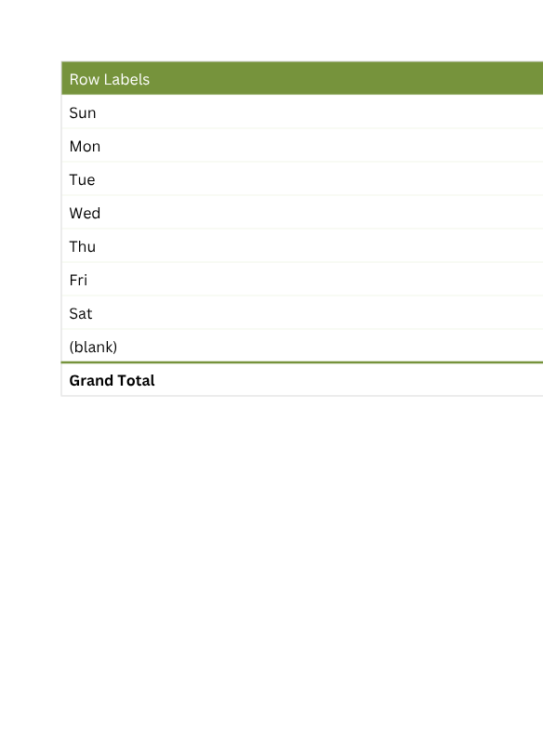
INSIGHTS
Total Revenue per Day of the Week
1️⃣ Weekend Revenue Peaks
Monday, Wednesday, and Thursday show the highest revenue, indicating strong week foot traffic.
2️⃣ Mid-Week Performance
Tuesday and Saturday also perform well, suggesting consistent customer flow.
3️⃣ Slowest Days
Friday appears to generate the lowest revenue, making it the best candidate for targeted promotions or loyalty incentives.

Slide 4
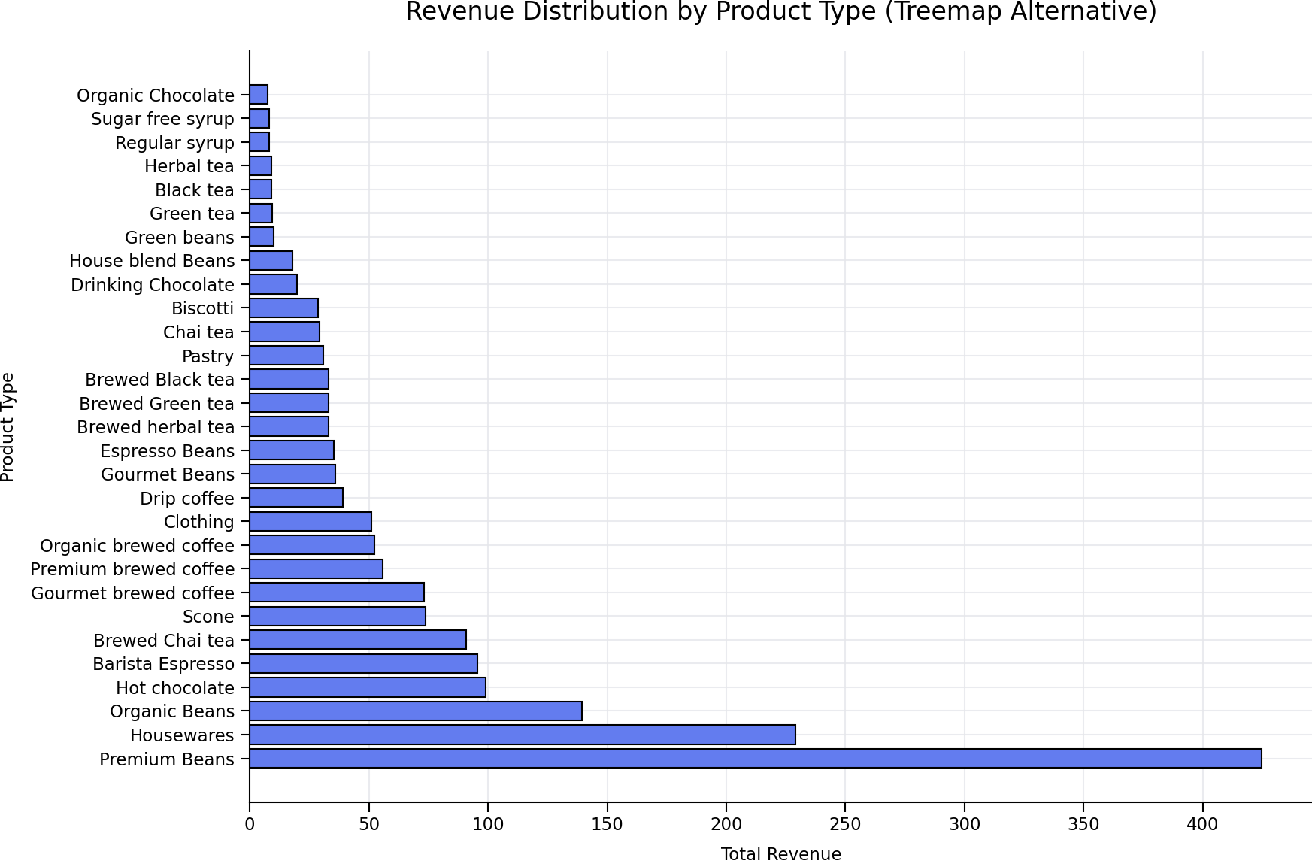

Slide 5
This confirms their high demand and premium pricing.
Premium Beans have highest revenue
TOTAL REVENUE
VS PRODUCT TYPR
Smaller blocks represent lower‑selling or lower‑priced items—ideal targets for repositioning or promotional strategies
t

Slide 6
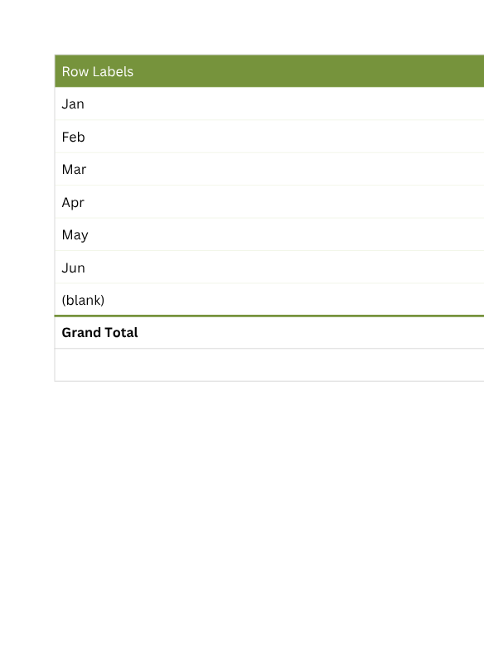
Recommendations
Lovelo Line
Revenue increases steadily from January → June, with the biggest jumps occurring:
Mar → Apr (+20k)
Apr → May (+38k)
May → Jun (+10k)

Slide 7
Capitalize on High Months (Apr–Jun)
Stock Up on Best-Selling Items
Based on earlier analysis (top items sold):
Brewed Chai Tea
Gourmet brewed coffee
Barista espresso
Scones
Peak months are ideal for:
Specials
Bundle offers or combos (Coffee + Pastry)
Slow Months (Jan & Feb)
Discounted morning deals
Special promotions
Tea + pastry combos
Happy hour for low foot traffic periods
Buy one get one free sprecials

Slide 8
THANK YOU

